Slide 1
Omni-channel Analysis
This is a manufactured dataset that is not part of our project data.
All concepts apply.

Slide 2
Question
What are the critical friction points in the customer journey that cause abandonment?
In this analysis, we are focusing on omni-channel touchpoints. This is just one of many sub-questions that can be asked.

Slide 3
Omni-channel (3+ channels used)
An omnichannel journey is a seamless, integrated customer experience where all retail channels (online, mobile, in-store, social, call center) work together as one unified system, with consistent information, pricing, and service regardless of how customers interact with the brand.
The investment in omnichannel capabilities typically pays back through:
15-35% increase in average transaction size
25% increase in customer lifetime value
10-30% reduction in operational costs
5-10% increase in customer satisfaction scores

Slide 4
Why Omni-channel?
Why It's Good for Customers
Convenience
Shop however and whenever they prefer
No need to restart shopping journey when switching channels
Save carts across devices
Access purchase history everywhere
Speed
Get products faster through flexible fulfillment
Skip lines with mobile checkout
Same-day pickup or delivery options
Instant inventory visibility
Better Service
Store associates can see full customer history
Personalized recommendations based on all interactions
Consistent support regardless of contact method
No need to re-explain issues when switching channels
Flexibility
Start returns online, complete in store
Buy online, return to store
Price match across channels
Use loyalty points anywhere
Why It's Good for Retailers
Increased Revenue
Omnichannel customers spend 2-3x more than single-channel customers
Higher lifetime value (30% higher on average)
Increased purchase frequency (shop 2x more often)
Larger basket sizes (13% higher average order value)
Better Customer Retention
Omnichannel customers have 90% higher retention rates
Stronger brand loyalty through consistent experiences
Reduced customer churn to competitors
Higher satisfaction scores
Operational Efficiency
Optimized inventory across all channels
Reduced dead stock through channel flexibility
Lower return rates (customers make better-informed decisions)
Better demand forecasting with unified data
Cost Optimization
Store network becomes fulfillment asset (ship-from-store)
Reduced shipping costs through BOPIS
Lower customer acquisition costs through retention
Better marketing ROI with unified attribution

Slide 5
Omni-channel Journey Dataset
Digital Only: Pure online journey
Digital Only: Pure online journey
Store Only: Pure physical journey
Store Only: Pure physical journey
Category | Columns
Customer & Journey Identifiers | First touch channel, last touch channel, channel, used email, etc.
Journey Metrics | Total touchpoints, days to purchase, device switches emails opened, social interaction
Purchase Details | Product, order value, purchase completed, cart abandonment stage
Fulfillment Options | BOPIS, Ship from store
CustomerAttributes | Age, loyalty member, lifetime value, Cust. satisfaction score
Flags | Return flag, cross sell flag
Identifiers | Customer id, journey type, season
An aggregate developed from a customer touchpoint dataset
ROPO: Research Online, Purchase Offline
Showrooming: Browse in store, buy online
Digital Only: Pure online journey
Store Only: Pure physical journey
Omnichannel: 3+ channels used
BOPIS: Buy online, Pick-up in store

Slide 6
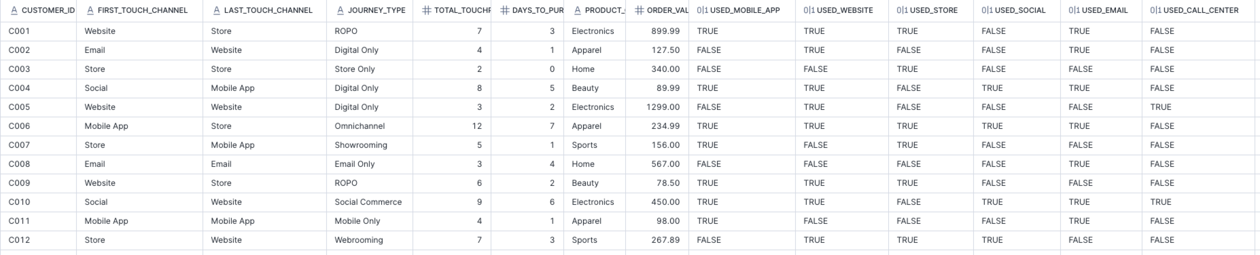
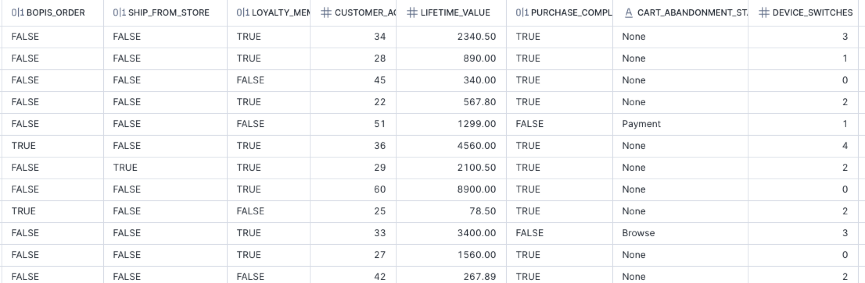
Some of the Data

Slide 7
Defining a Journey
The dataset has a journey type named Omni-channel. This type makes up 1% of the rows.
There are actually multiple journey types that can be considered Omni-channel. ROPO, Cross-device type and other types are aggregated with Omni-channel to provide a complete picture of journeys with three or more touchpoints. The aggregate represents 52% of the rows.
This analysis has a very simplified view of a journey:
One journey per customer
No journey separation (all customer touchpoints are bundled together)
Arbitrary timeframes (assumes one continuous journey)

Slide 8
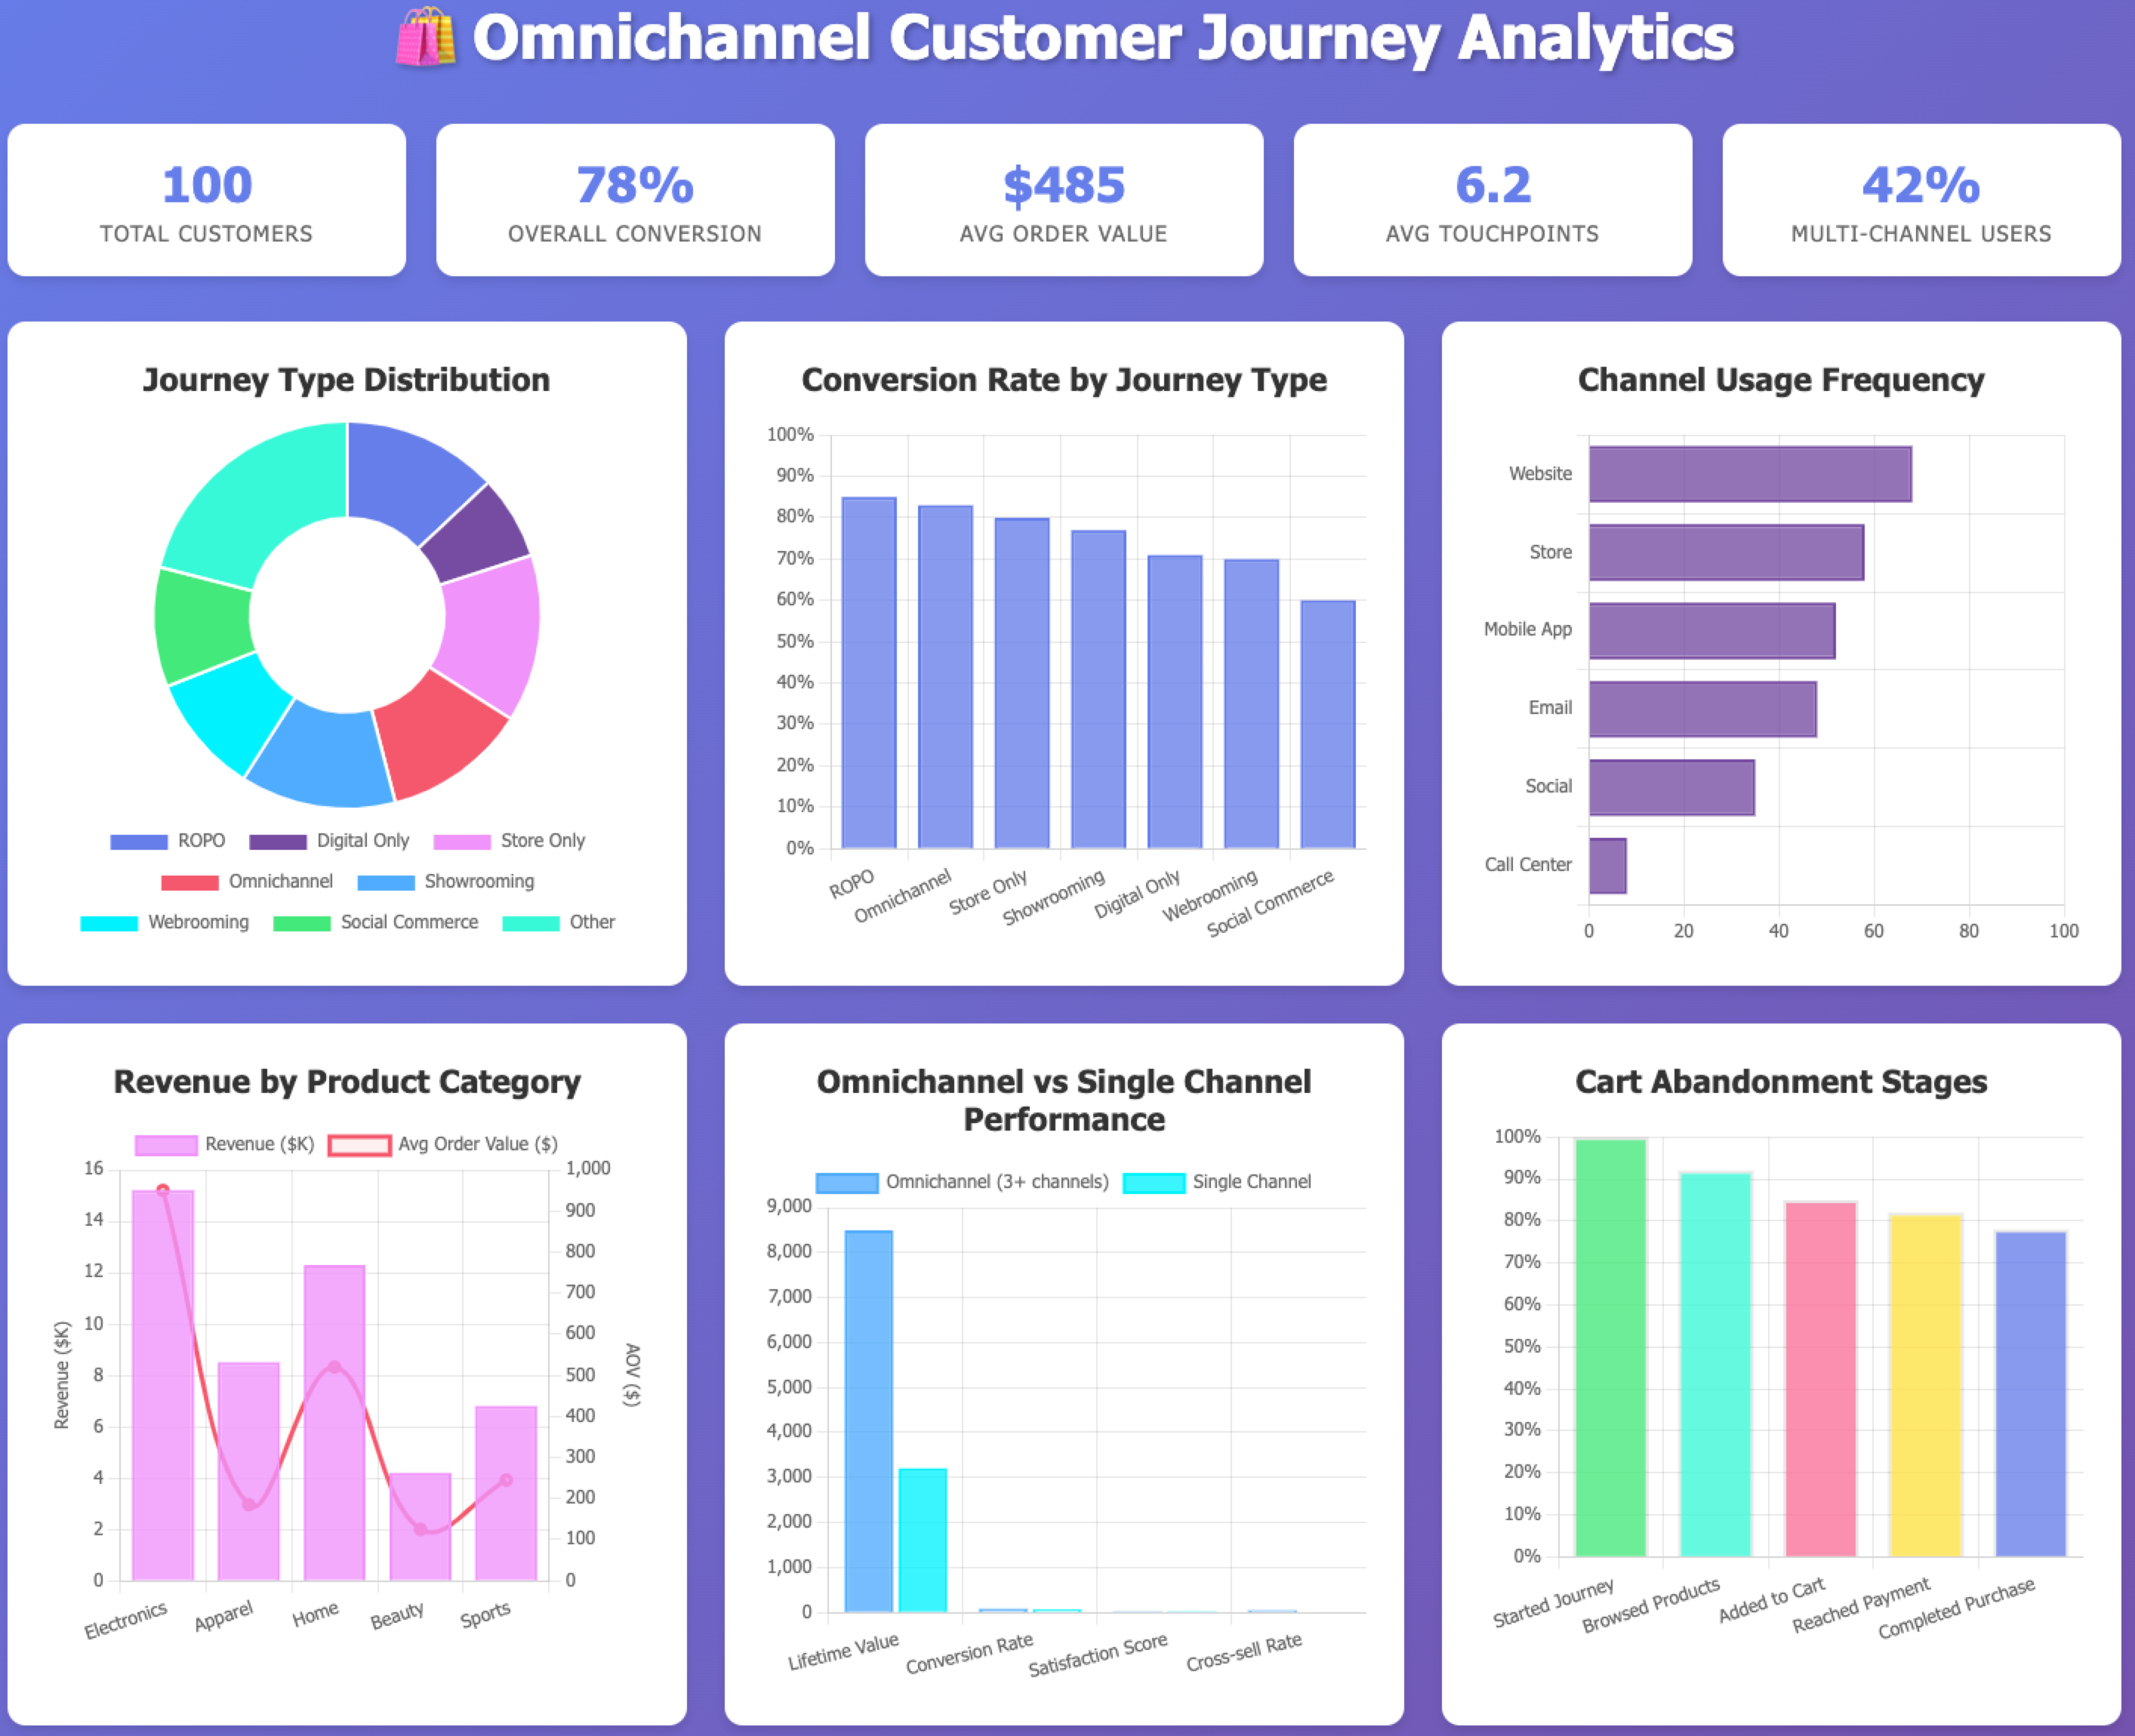
These metrics represent the questions the descriptive measure we thought would guide us in answering the question

Slide 9
Critical Questions to Diagnose Omni-channel Friction
Channel Transition Barriers
Authentication Friction: Do customers need to create separate accounts for app, website, and in-store purchases?
Cart Persistence: When customers add items on mobile, can they see them on desktop? How long do carts persist?
Price Inconsistency: Are prices/promotions the same across all channels, or do customers see different offers?
Inventory Visibility: Can customers see real-time store inventory online? Can store associates see online inventory?
Technology & Infrastructure Gaps
Mobile App Adoption: Why are only 52% using the mobile app? Is it:
Difficult to discover/download?
Poor app store ratings?
Large app size?
Frequent crashes or bugs?
Website Mobile Experience: Is the mobile web experience pushing users to app, or is it fully functional?
In-Store Digital Tools: Do stores have:
WiFi for customers?
QR codes for product information?
Digital kiosks for extended inventory?
Mobile POS for line-busting?
Notice that these are not all ‘data analysis questions.
Think about: People, Process, Product, Price, Place, Promotion, Platform

Slide 10
Remember
Sometimes our analysis just results in more projects to do more analysis.

Slide 11
More Questions that can be Asked
Customer Identity and Data
Fulfillment and Service Limitations
Journey-specific Friction (Are stores too far for digital only)
Communication and Marketing Alignment
Competitive & Market Factors

Slide 12
Customer Transition Friction Analysis
Cart loss >20% = Major sync issues
Item reduction = Partial cart persistence problems
Specific channel pairs with high loss = Integration gaps
Where do customers fail to complete transitions?
Key Friction Indicators:
Low success rates (<50%) indicate friction
Long delays (>24 hours) suggest re-authentication issues
Missing transitions (certain paths never occur) reveal blocking barriers
Are carts abandoned at channel switching?
Key Friction Indicators:
Cart loss > 20% = Major sync issues
Item reduction = Partial cart persistence problems
Specific channel pairs with high loss = Integration gaps
Key friction indicators are developed beforehand. Usually with SMEs

Slide 13
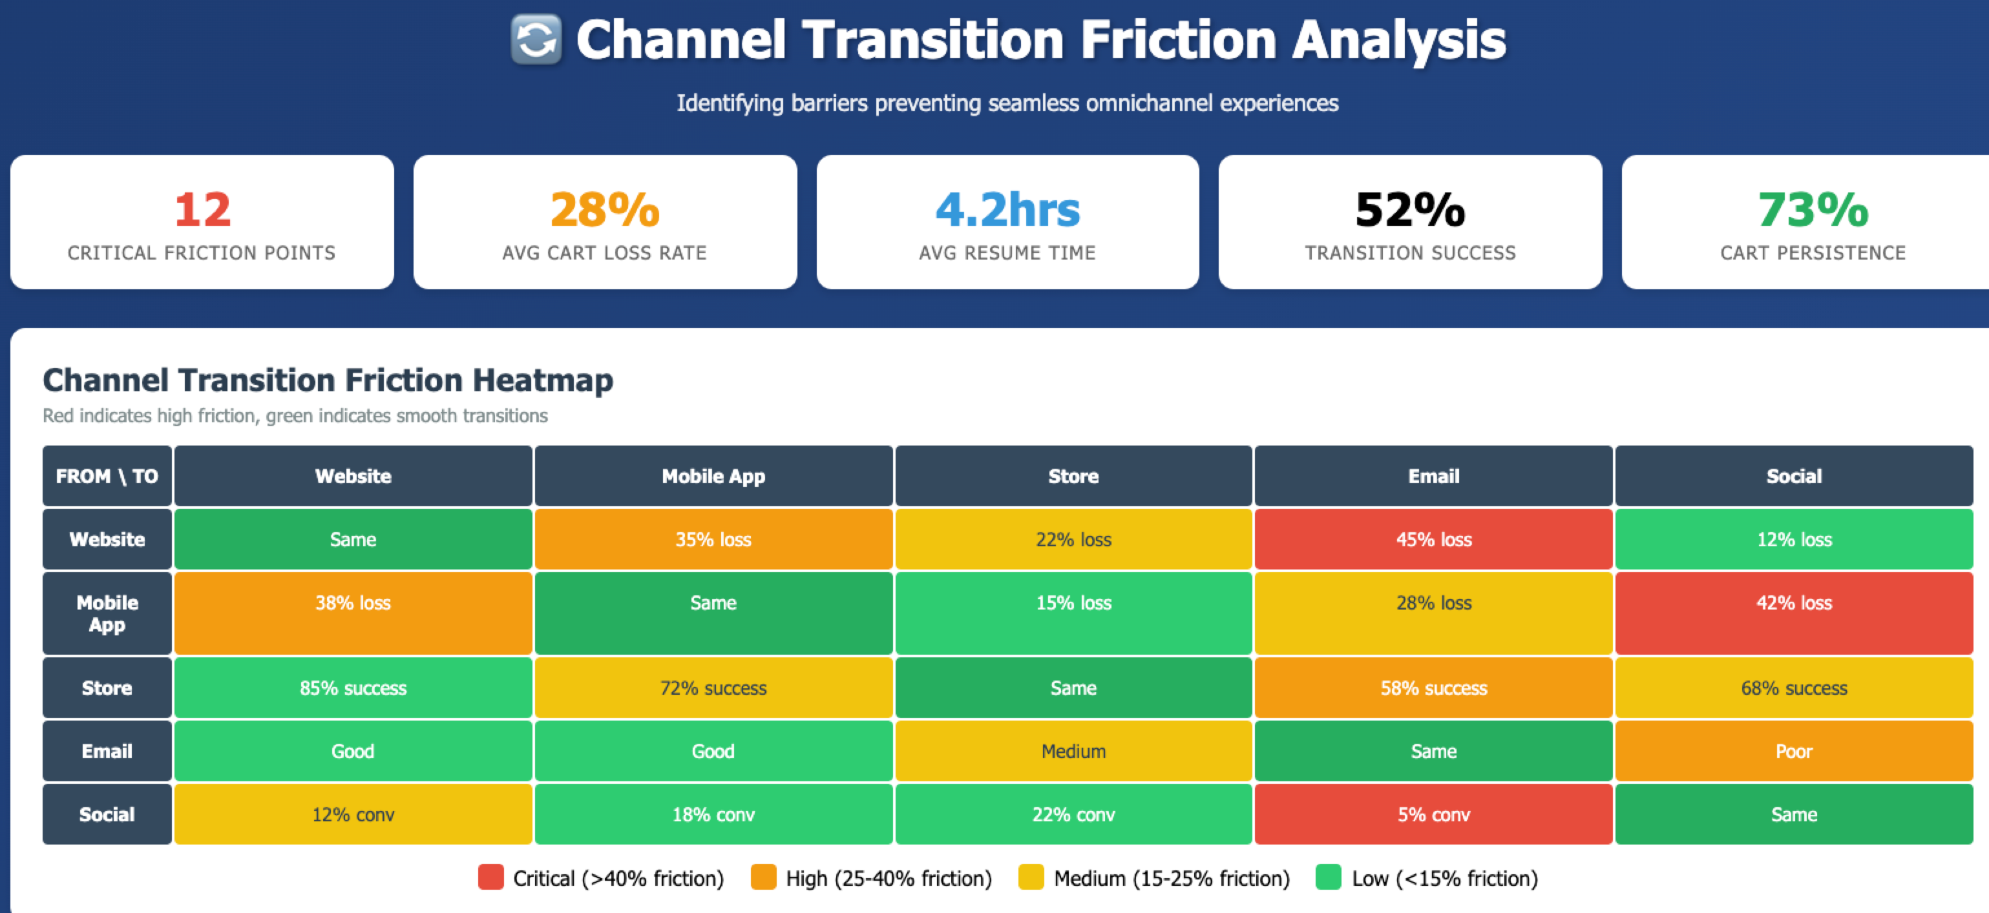
Results

Slide 14
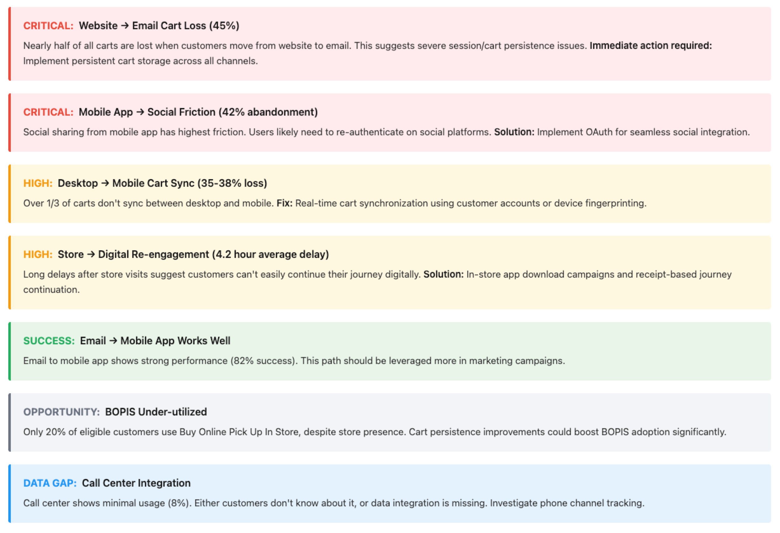
Critical Findings & Recommendations

Slide 15
Critique the Dashboard

